Slide 1


Deep Learning (DL)
Lab4
Natural Language Processing (NLP)
Preprocessing

Slide 2
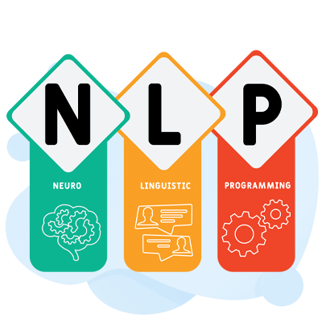
What is Natural Language Processing(NLP) ?
How to make language understandable to computers?
NLP is deeply tied to the sequential nature of language.
Sequences of words, phrases, or sentences are key to understanding meaning, context, and relationships between different parts of text.
Then develop algorithms to operate on the input language:
CS
AI
Linguistics اللغويات

Slide 3
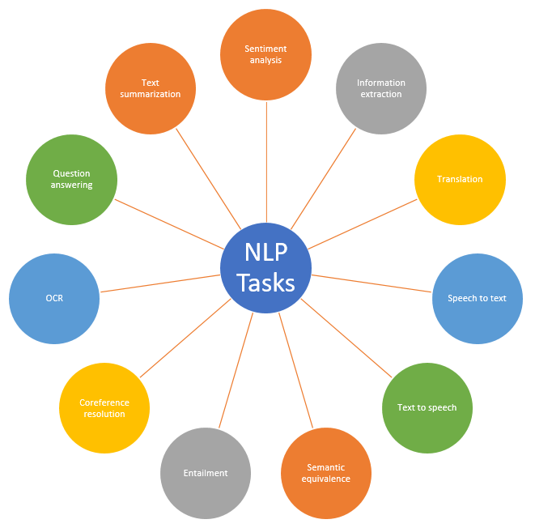
What are NLP tasks?

Slide 4
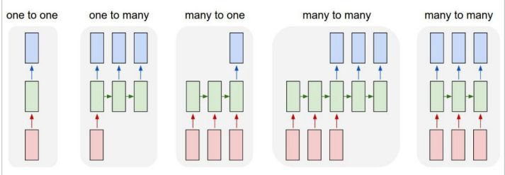
Encoder-Decoder pattern
image classification
image captioning
sentiment analysis
Machine Translation

Slide 5
Why NLP is hard?
Human Language is difficult
Symbolic: Uses symbols to convey meaning. الرموز
Implicit Meaning: Includes indirect cues (e.g., sarcasm). سخرية
Multiple Encodings: Same meaning can have different expressions (gestures, emoticons, speech). نفس المعنى
Sparse Vocabulary: Huge vocabulary set. كلمات كثيرة
Diverse: Encompasses multiple languages, dialects, and accents. لغات ولهجات مختلفة

Slide 6
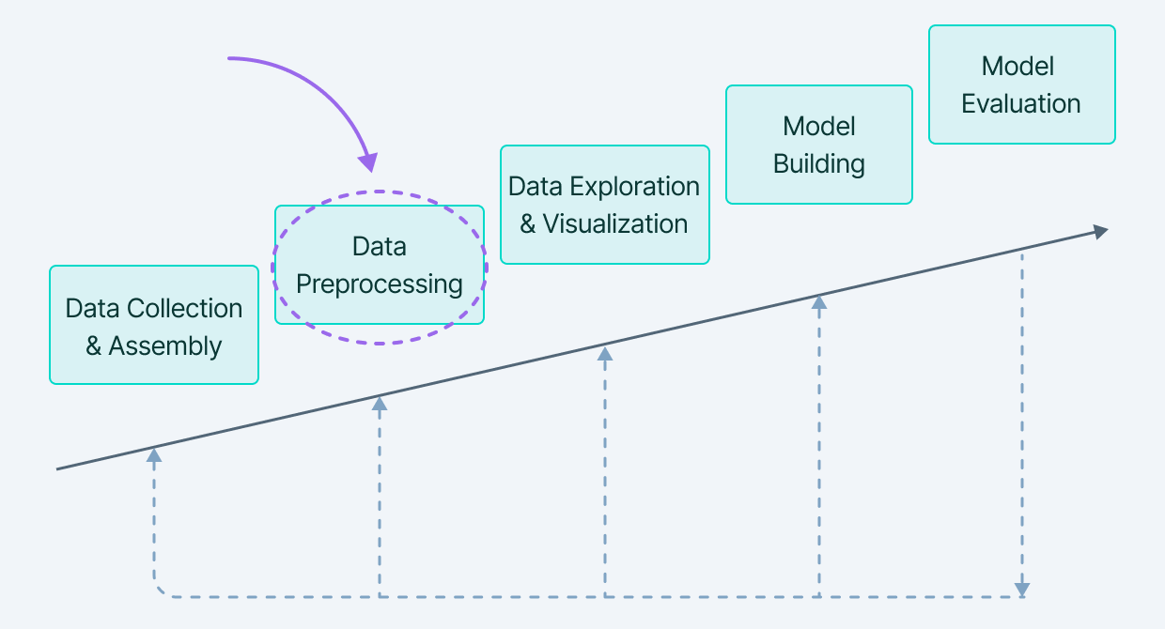
Cycle of Natural Language Processing

Slide 7
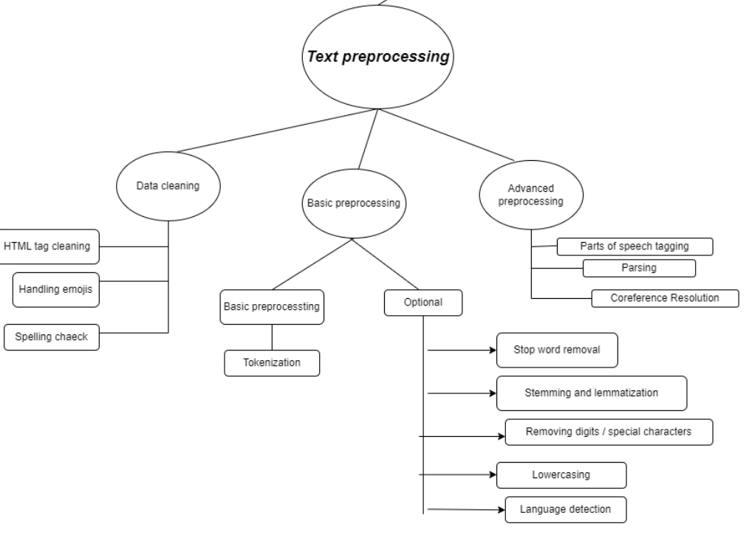

Slide 8
Data Cleaning

Slide 9
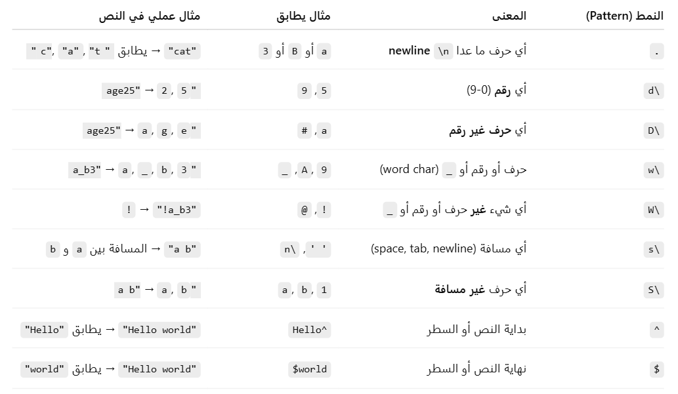
Regular Expression (re)

Slide 10
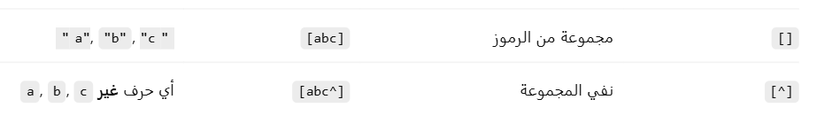
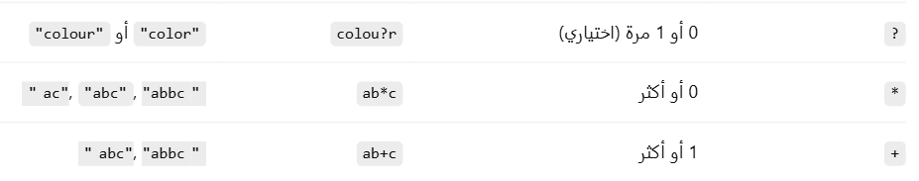
Regular Expression (re)

Slide 11
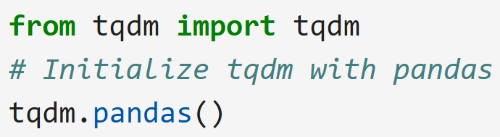

Slide 12
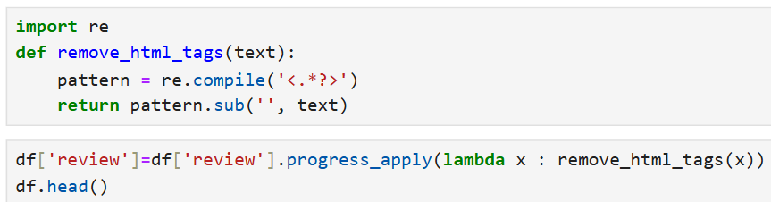
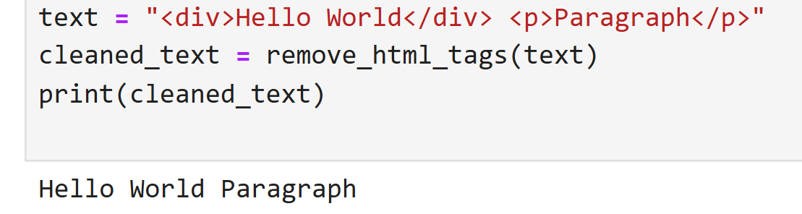
Remove html tags using Regular expressions

Slide 13
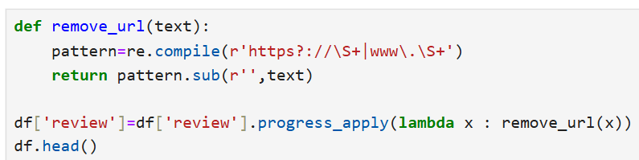
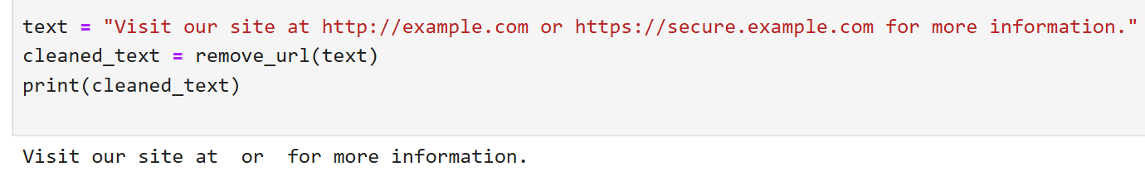
Removing URLs

Slide 14
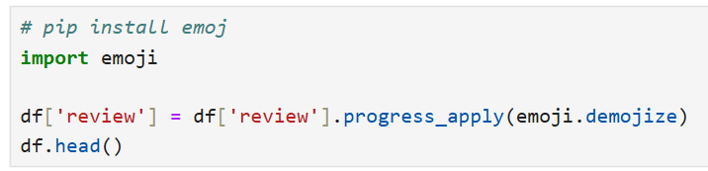
Handling emojis

Slide 15
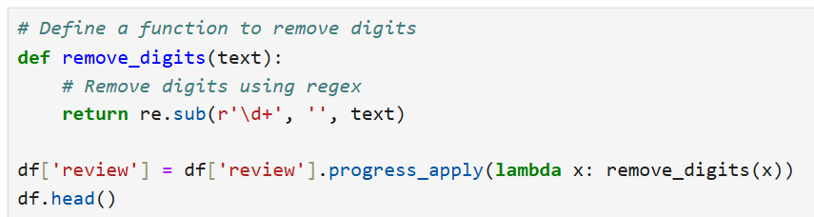
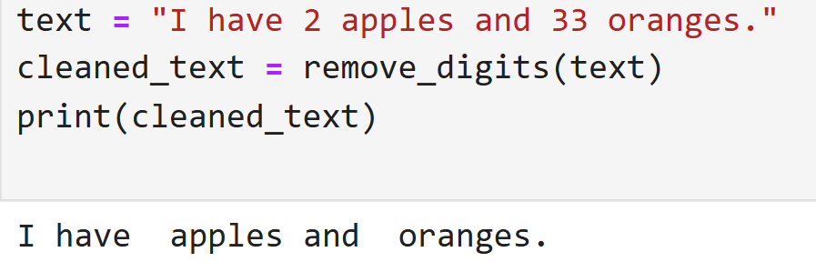
Remove digits

Slide 16
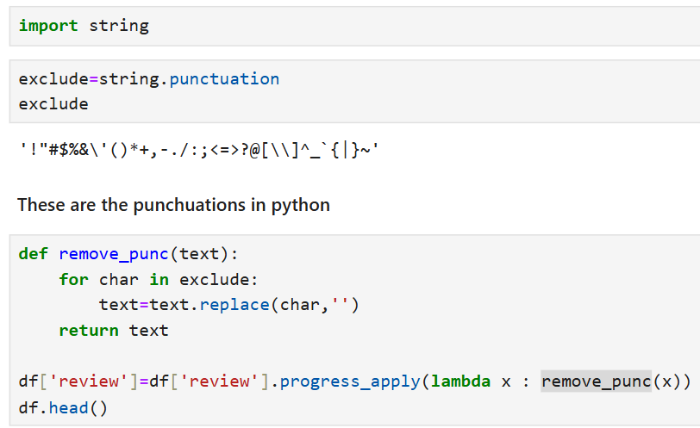
Remove Punctuation

Slide 17
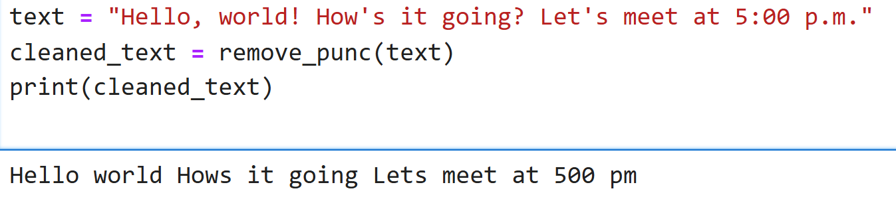
Remove Punctuation

Slide 18
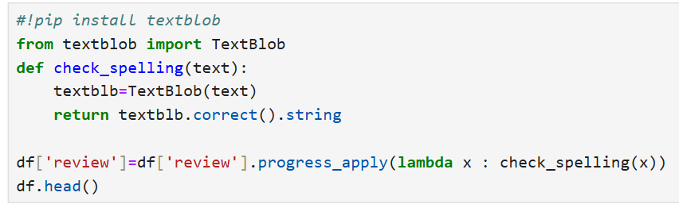
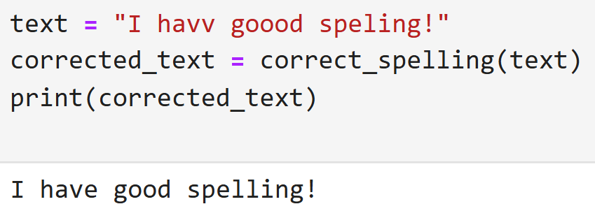
Spelling correction

Slide 19
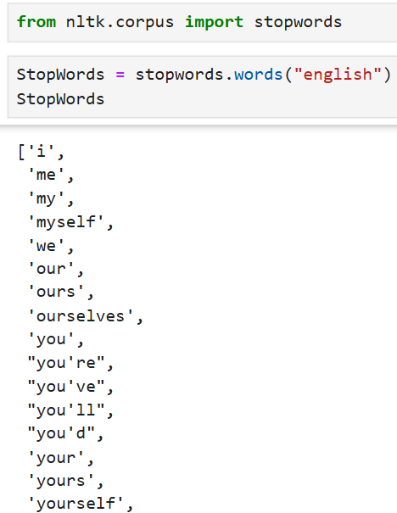
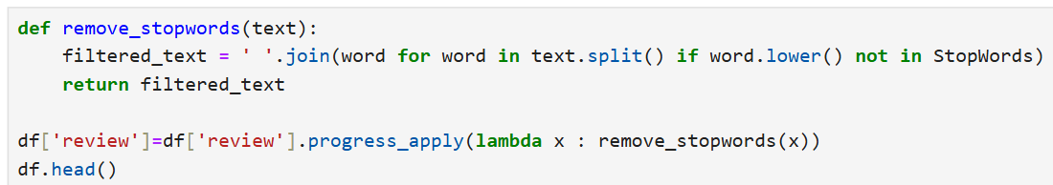
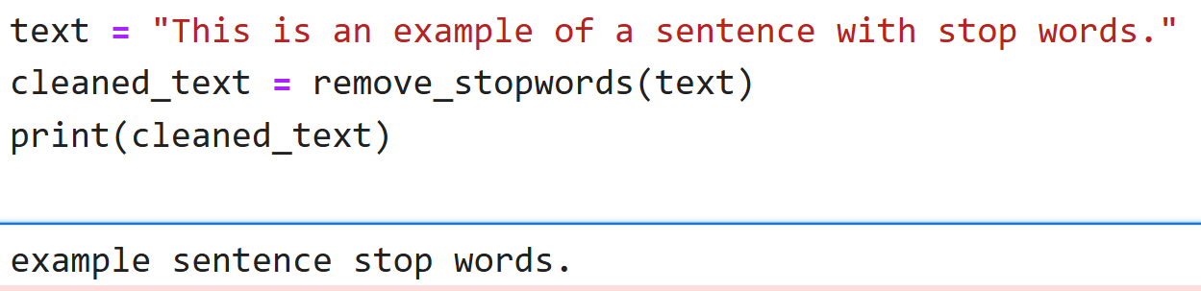
Removing StopWords

Slide 20
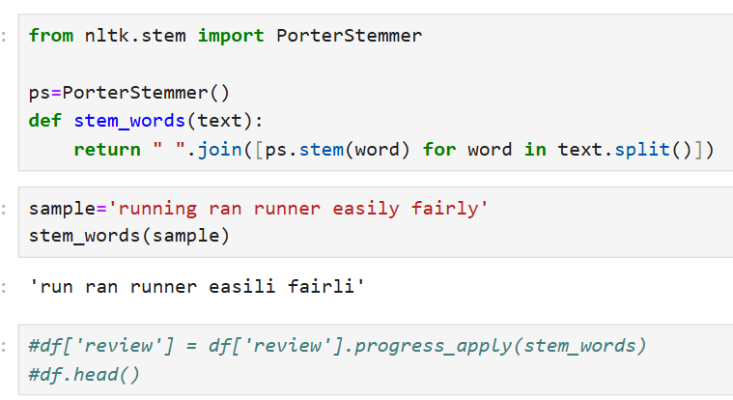
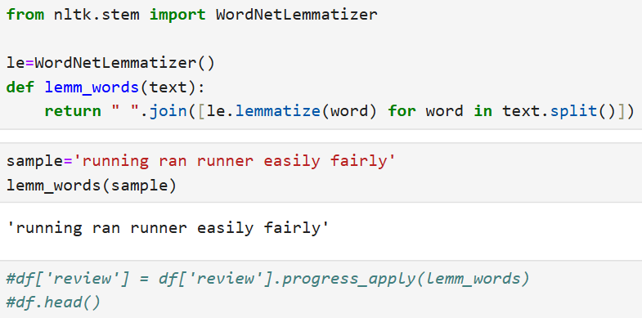

Stemming & Lemmatization
Stemming is the process of shortening words by removing suffixes, often resulting in non-precise words. It relies on simple rules, such as removing suffixes, without considering the meaning of the word.
Lemmatization is the process of converting a word to its correct linguistic base form, called the "lemma," considering the word’s meaning and context.
Lemmatization usually requires advanced libraries and grammar rules.
Key Difference
Stemming is faster but may yield imprecise roots.
Lemmatization is more accurate and considers grammatical meaning, but it is slower.

Slide 21
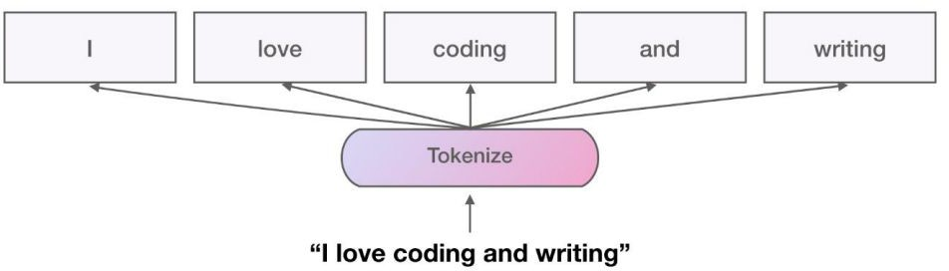
Tokenization
Tokenization Splitting the text into individual words or tokens. For example, "Hello world!" becomes ["Hello", "world", "!"].
The final Goal of Tokenization is : Creating Vocabulary
Python’s split() function
Regular Expressions (RegEx)
NLTK library
SpaCy library
Gensim library

Slide 22
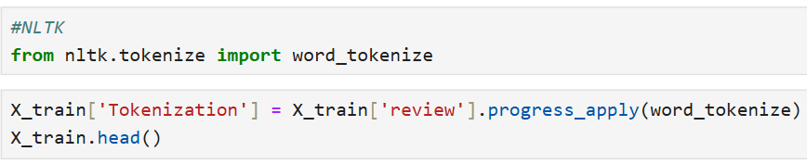
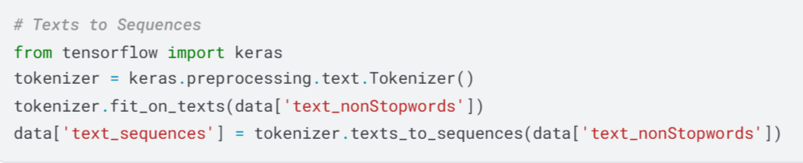
Tokenization

Slide 23
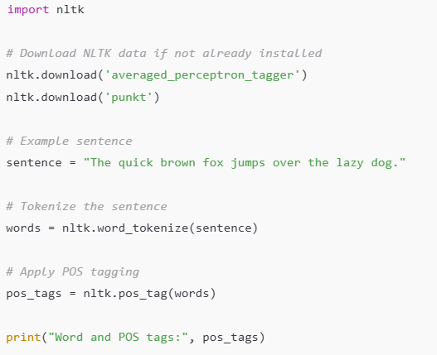
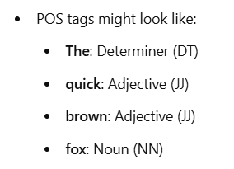
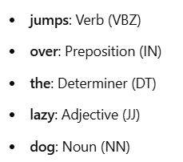
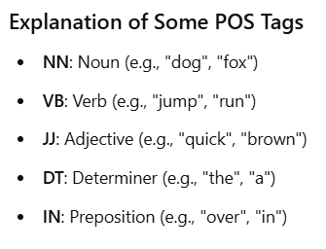
Part-of-Speech (POS)
Part-of-Speech (POS) Tagging is the process of identifying the grammatical category of each word in a text, such as noun, verb, adjective, etc.
POS tagging is crucial in Natural Language Processing (NLP) as it helps understand the structure and meaning of sentences.
Each word in a sentence is assigned a tag representing its part of speech, which provides information about the word’s role in the sentence.

Slide 24
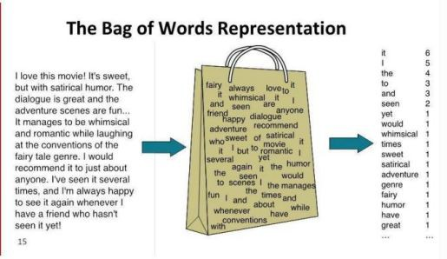
Bag of Words (BoW)
Bag of Words (BoW) is represented as a collection of words without considering grammar, order, or structure. This method focuses on the presence and frequency of words, making it a simple yet effective approach for converting text into numerical features for machine learning models.
Tokenization: Break down each document into individual words (tokens).
Vocabulary Creation: Create a set of unique words (vocabulary) across all documents in the dataset.
Vectorization: Represent each document as a vector of word counts based on the vocabulary.

Slide 25
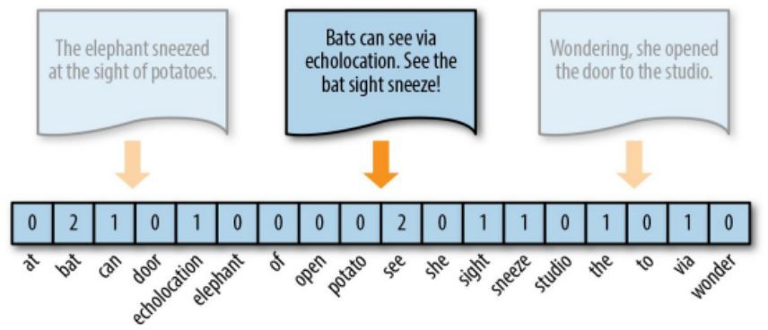
Vectorization
Vectorizing : The process that we use to convert text to a form that Python and a machine learning model can understand
It is defined as the process of encoding text as integers to create feature vectors
Build vocab
Register the index of the word from the vocab
Not in vocab? □ store as UNK
Need to pad? □ encode as PAD = 0
There are many vectorization techniques, we will focus on the three widely used vectorization techniques:
Count vectorization
N-Grams.
Term frequency - inverse document frequency (TF-IDF)

Slide 26
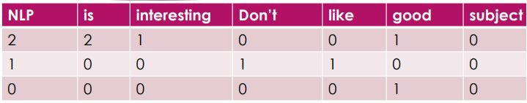
1- Count vectorization- Document term matrix
This means, if a particular word appears many times in spam or ham message
,then the particular word has a high predictive power of determining if the message is a spam or ham .
NLP is interesting , NLP is good
Don’t like NLP
good subject

Slide 27
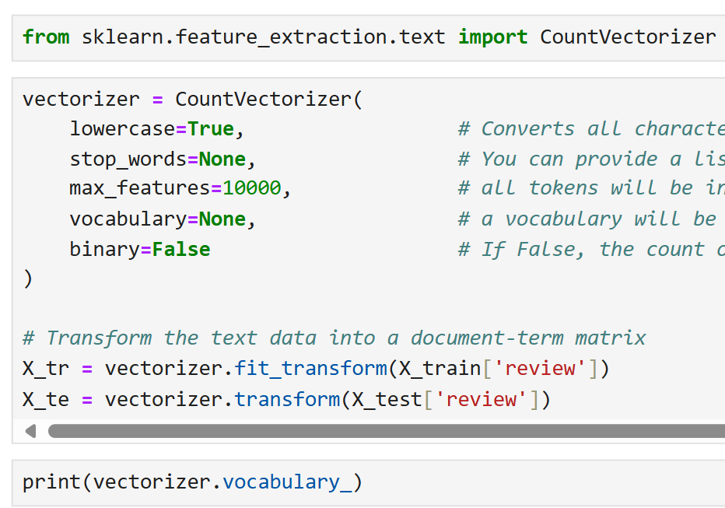
1- Count vectorization- Document term matrix

Slide 28
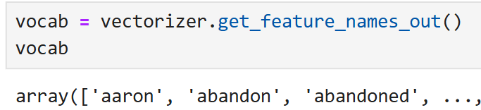
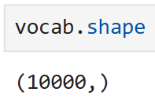
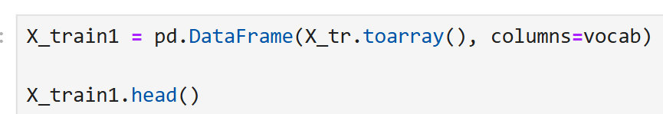
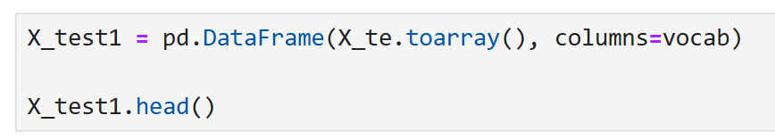
1- Count vectorization- Document term matrix

Slide 29
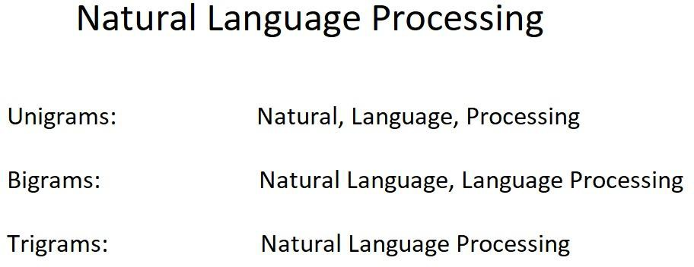
2- N-gram vectorizing
The n-grams process creates a document-term matrix like we saw before. Now we still have one row per text message and we still have counts that occupy the individual cells but instead of the columns representing single terms ,here ;all combinations of adjacent words of length and in your text.
As an example, let's use the string Natural Language Processing.

Slide 30
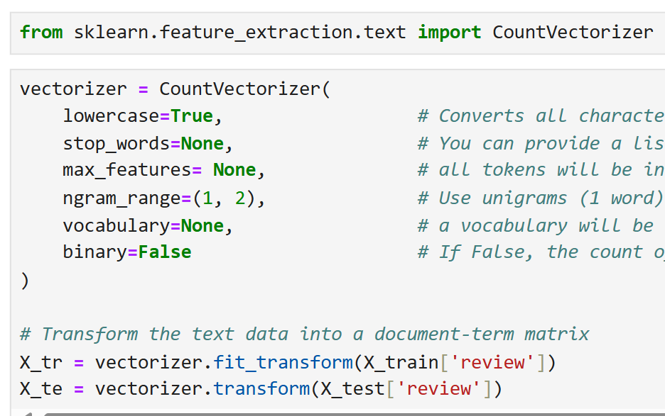
2.1 N-gram vectorizing(1,2)

Slide 31
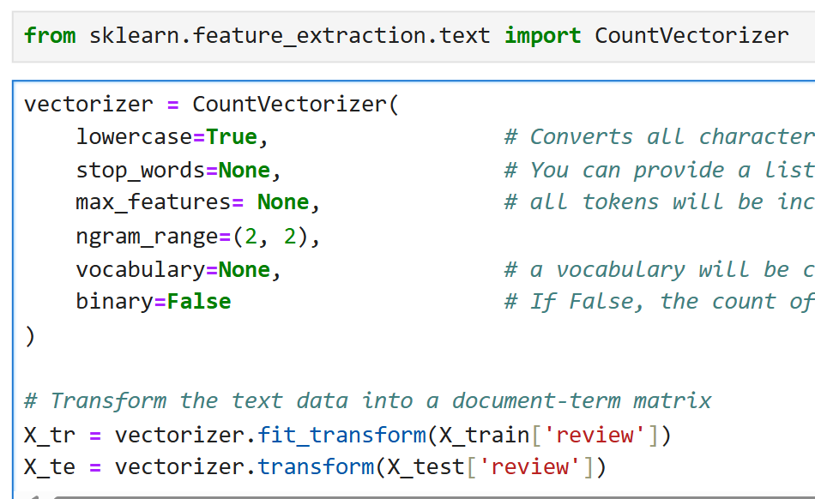
2.2 N-gram vectorizing(2,2)

Slide 32
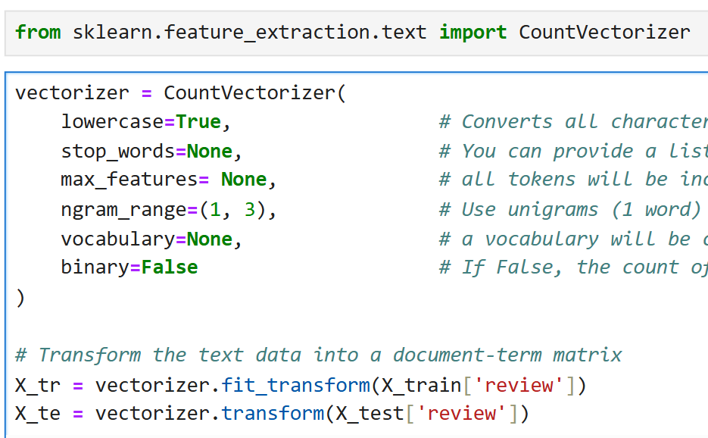
2.3 N-gram vectorizing(1,3)

Slide 33
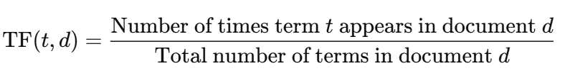
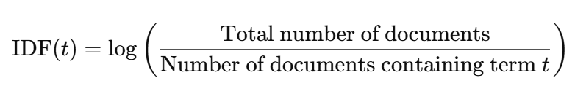

3. Term frequency - inverse document frequency (TF-IDF)
TF-IDF creates a document term matrix, where there's still one row per text message and the columns still represent single unique terms.
But instead of the cells representing the count, the cells represent a weighting that's meant to identify how important a word is to an individual text message.
weighting = TF*IDF
Term Frequency (TF): This measures how frequently a term appears in a document. It is often calculated as:
Inverse Document Frequency (IDF): This measures how important a term is across the entire corpus. It helps to down weight common words that appear in many documents. IDF is calculated as:
TF-IDF Calculation: The TF-IDF score for a term is the product of its TF and IDF scores:

Slide 34
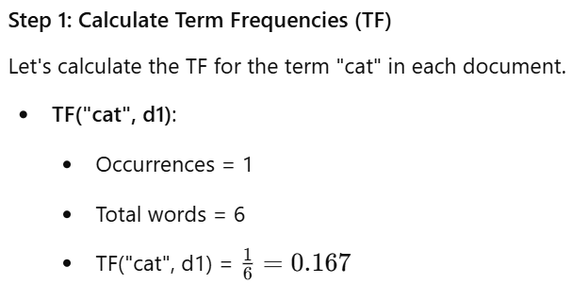
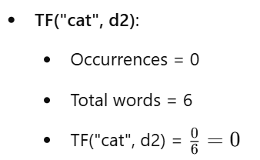
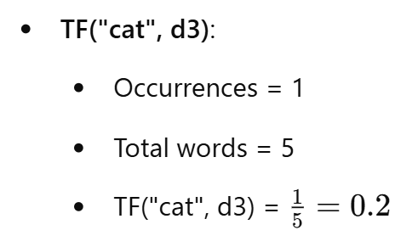
3. TF-IDF- How to Compute:
Documents
D1: "the cat sat on the mat“ || D2: "the dog sat on the log“ || D3: "the cat chased the dog"

Slide 35
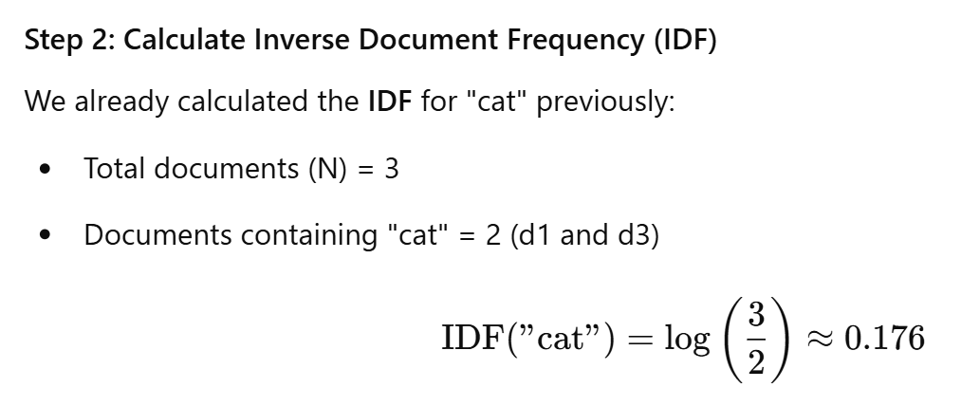
3. TF-IDF- How to Compute:
Documents
D1: "the cat sat on the mat“ || D2: "the dog sat on the log“ || D3: "the cat chased the dog"

Slide 36


3. TF-IDF- How to Compute:

Slide 37


3. Term frequency - inverse document frequency (TF-IDF)

Slide 38
Thanks

